Slide 1
Data Analytics Bootcamp « Exploring the S&P 500 »
Dec. 2nd, 2022
Raphael Hersant

Slide 2
Agenda
Initial hypothesis
I
Getting the data
II
Capital IQ & Refinitiv
II.1
Quandl
II.1
Visualizing the data and first comments
III
Forecasting the price of the S&P 500
IV
Linear Regression Model
IV.2
Monte Carlo Simulation
IV.2
Prophet
IV.2
Conclusion
IV

Slide 3
01
Initial hypothesis

Slide 4
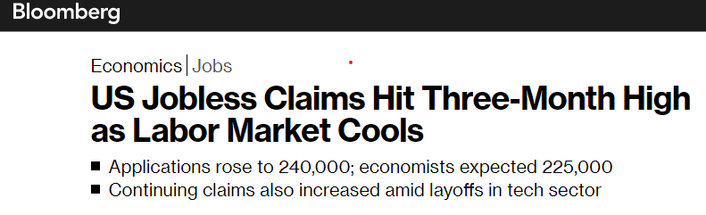
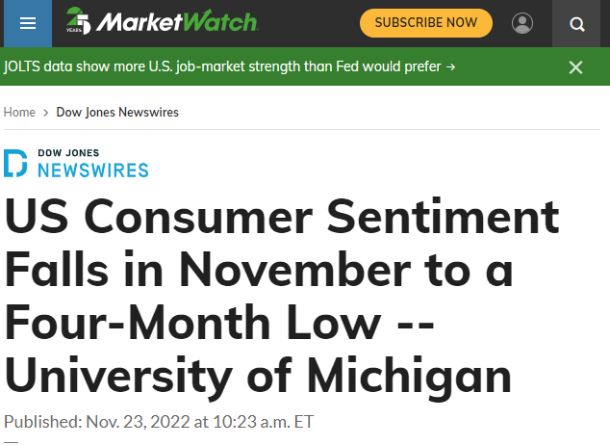
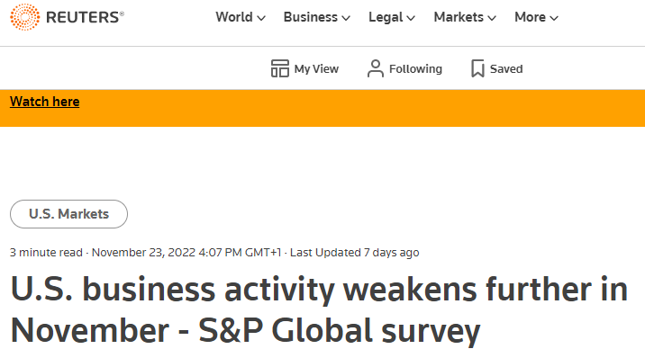
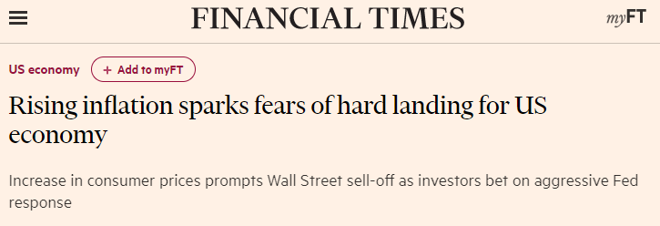
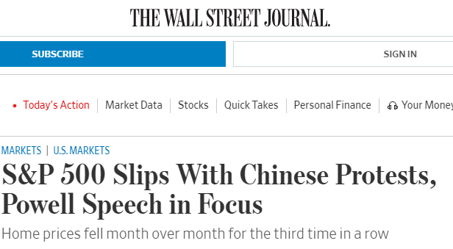
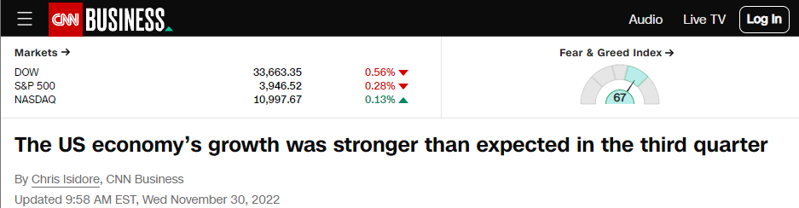
We are getting bombarded daily by anxious financial news
Source: Bloomberg, CNN Business, Financial Times, MarketWatch, Reuters, The Wall Street Journal
Notes:
https://www.bloomberg.com/news/articles/2022-11-23/us-jobless-claims-hit-three-month-high-as-labor-market-cools
https://www.wsj.com/articles/global-stocks-markets-dow-update-11-29-2022-11669722875
https://www.ft.com/content/ed54e347-38f0-42e9-befe-450f36443de8
https://edition.cnn.com/2022/11/30/economy/us-gdp-third-quarter/index.html
https://www.marketwatch.com/story/us-consumer-sentiment-falls-in-november-to-a-four-month-low-university-of-michigan-271669217038

Slide 5


What we are going to answer today
How did these indicators evolve during the last years
and see if we can legitimately be worried?
Using the knowledge we acquired during the last weeks, we will try to predict
the evolution of the S&P 500
Notes:
https://www.bloomberg.com/news/articles/2022-11-23/us-jobless-claims-hit-three-month-high-as-labor-market-cools
https://www.wsj.com/articles/global-stocks-markets-dow-update-11-29-2022-11669722875
https://www.ft.com/content/ed54e347-38f0-42e9-befe-450f36443de8
https://edition.cnn.com/2022/11/30/economy/us-gdp-third-quarter/index.html
https://www.marketwatch.com/story/us-consumer-sentiment-falls-in-november-to-a-four-month-low-university-of-michigan-271669217038

Slide 6
02
Getting the data

Slide 7
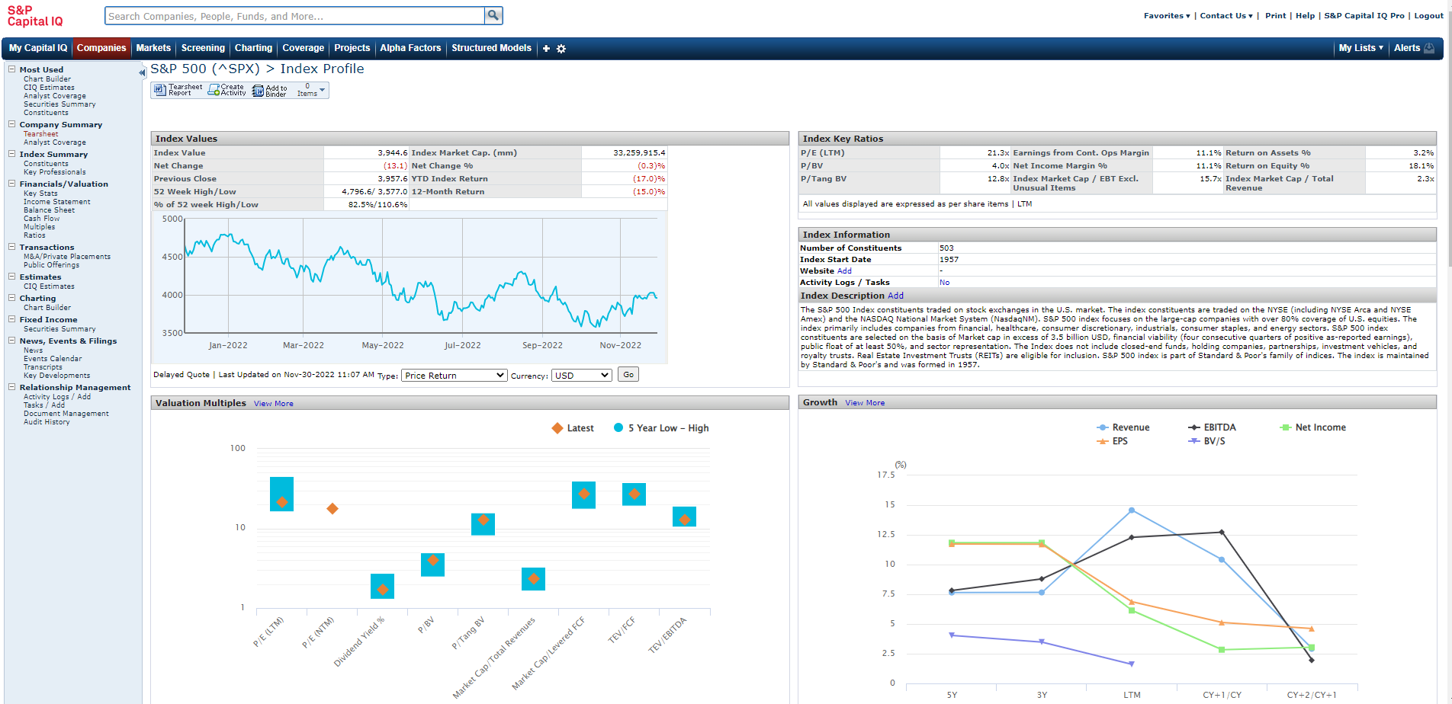
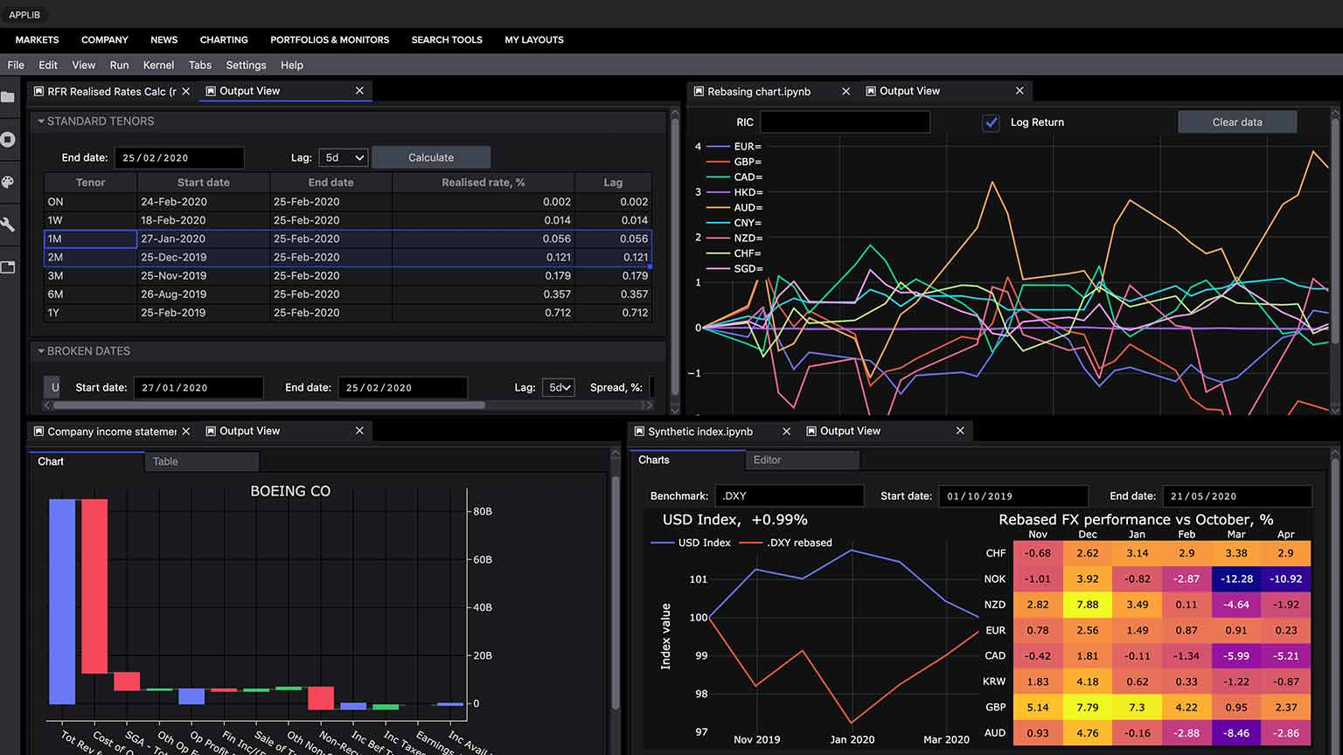
Trying to get the data with traditional providers
Capital IQ
Refinitiv
CapIQ is a market intelligence platform designed by Standard & Poor's (S&P). The platform is used in many areas of corporate finance, including investment banking, equity research or asset management.
Refinitiv Eikon is an open-technology solution for financial markets professionals, providing access to industry-leading data, insights, and exclusive and trusted news.
Collected Data
Collected Data
US GDP from 1927 to 2022 (quarterly release)
US CPI 1914-2022 - Monthly basis
US Unemployment Rate 1948-2022 - Monthly basis
S&P 500 1928-2022 - Daily Basis
Monthly Home Price Index 2008-2022 - Monthly basis
Initial Jobless Claim 2004-2022 - Weekly basis
Core CPI 1996-2022 - Monthly Basis
Consumer Credit 2004-2022 - Monthly basis
Non-Farm Payrolls 2004-2022 - Monthly basis
Chicago PMI 2004-2022 - Monthly basis
User interface
User Interface
Source: Corporate Finance Institute, CapitalIQ, Refinitiv

Slide 8
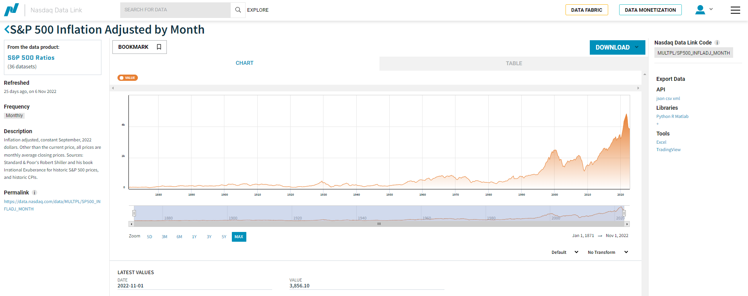
Quandl, an open free API, is the solution to all our problems
Quandl
Data Source
Quandl is a premier publisher of alternative data for institutional investors. A dedicated team of data scientists, quants and engineers combine uncompromising curation, high-quality standards and experienced data science application to provide some of the most robust data available today. It was acquired by Nasdaq in 2018, and explain now why it is integrated within the Nasdaq website.
Providers:
Exchange Data International
Worldvest Base
Trading Economics
Quandl
Sources:
Central Banks
Federal Reserve of Economics Data
IMF
World Banks
Source: Quandl

Slide 9
These are the different indicators that were downloaded
Big Mac Index
2000-2022
Semi-annual
The big mac index was invented by The Economist in 1986 as a lighthearted guide to whether currencies are at their “correct” level. It is based on the theory of purchasing-power parity (PPP), the notion that in the long run exchange rates should move towards the rate that would equalise the prices of an identical basket of goods and services (in this case, a burger) in any two countries
M2
1959-2022
Monthly
M2 is a measure of the U.S. money stock that includes M1 (currency and coins held by the non-bank public, checkable deposits, and travelers' checks) plus savings deposits (including money market deposit accounts), small time deposits under $100,000, and shares in retail money market mutual funds
Consumer Sentiment
1952-2022
Quarterly/
Annual
The US Index of Consumer Sentiment (ICS), as provided by University of Michigan, tracks consumer sen<<<<<<<timent in the US, based on surveys on random samples of US households. The index aids in measuring consumer sentiments in personal finances, business conditions, among other topics. Historically, the index displays pessimism in consumers' confidence during recessionary periods, and increased consumer confidence in expansionary periods
Initial Claims
1967-2022
Weekly
Jobless claims are a statistic reported weekly by the U.S. Department of Labor that counts people filing to receive unemployment insurance benefits. There are two categories of jobless claims—initial, which comprises people filing for the first time, and continuing, which consists of unemployed people who have already been receiving unemployment benefits. Jobless claims are an important leading indicator of the state of the employment situation and the health of the economy
CPI
1913-2022
Monthly
The Consumer Price Index (CPI) is a measure of the average change over time in the prices paid by urban consumers for a market basket of consumer goods and services. Indexes are available for the U.S. and various geographic areas. Average price data for select utility, automotive fuel, and food items are also available
Revolving Credit
1968-2022
Monthly
The big mac index was invented by The Economist in 1986 as a lighthearted guide to whether currencies are at their “correct” level. It is based on the theory of purchasing-power parity (PPP), the notion that in the long run exchange rates should move towards the rate that would equalise the prices of an identical basket of goods and services (in this case, a burger) in any two countries
GDP-GDI
1949-2022
Quarterly/
Annual
GDI and GDP are two slightly different measures of a nation's economic activity. GDI counts what all participants in the economy make or "take in" (like wages, profits, and taxes). GDP counts the value of what the economy produces (like goods, services, and technology)
S&P 500
1871-2022
Monthly
The S&P 500 is an equity index made up of 500 of the largest companies traded on either the NYSE, Nasdaq, or Cboe. The S&P 500 is calculated by adding each company's float-adjusted market capitalization
PMI
1948-2022
Monthly
The ISM manufacturing index, also known as the purchasing managers' index (PMI), is a monthly indicator of U.S. economic activity based on a survey of purchasing managers at more than 300 manufacturing firms. It is considered to be a key indicator of the state of the U.S. economy
Source: Bureau of Labor Statistics, The Economist, Investopedia, St.Louis Fed, Ycharts

Slide 10
03
Visualizing the data and first comments

Slide 11
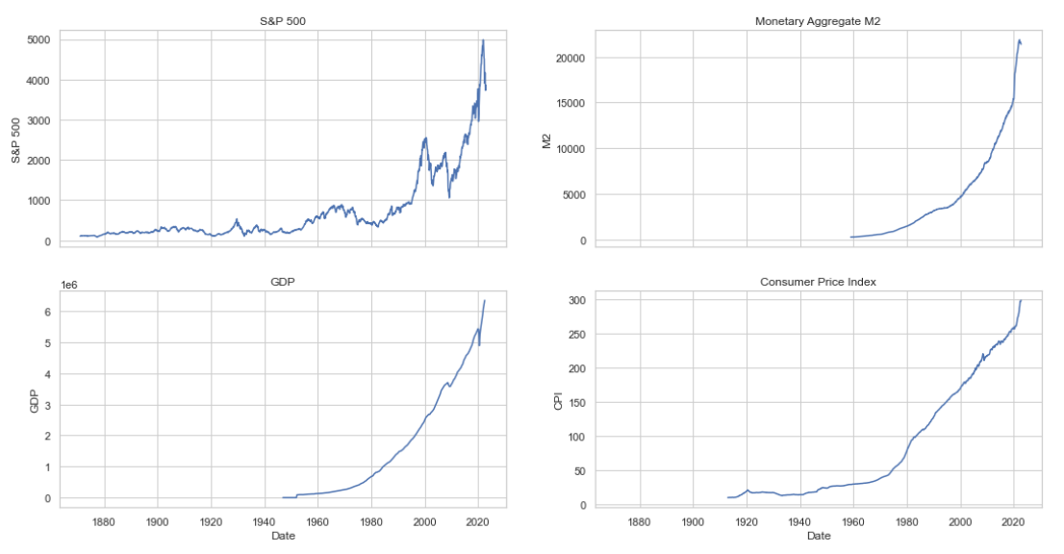
4 economic indicators seem to follow a similar pattern
Source: Quandl

Slide 12
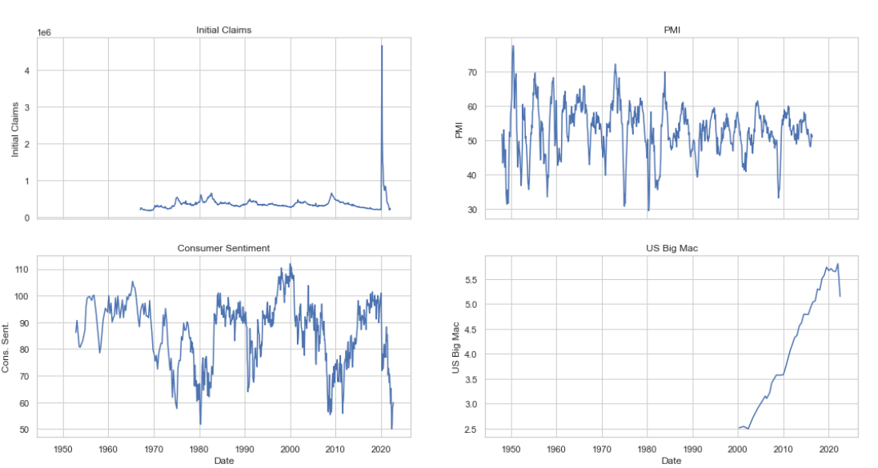
Consumer Sentiment and PMI are at an alarming level
Source: Quandl

Slide 13
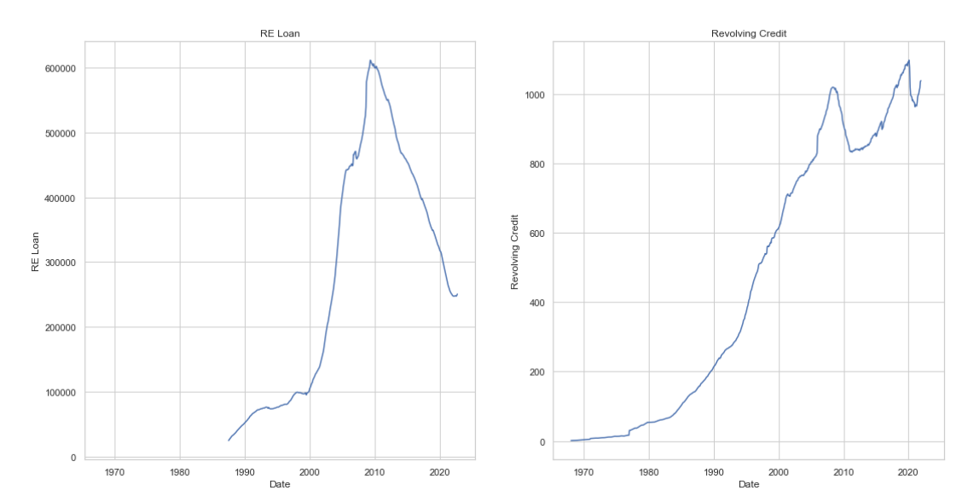
We will not return to a subprime crisis, but cons. credits are at record levels
Source: Quandl

Slide 14
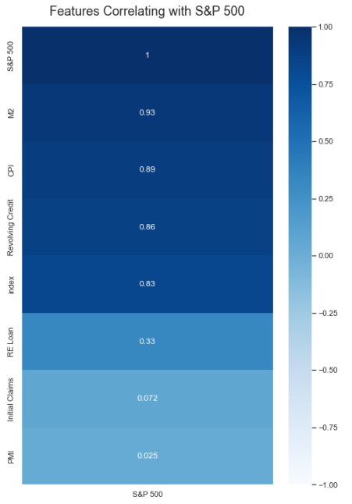
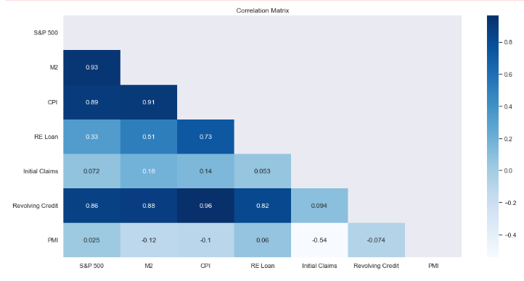
S&P 500 is highly correlated to M2, CPI and Revolving Credit…
Source: Quandl

Slide 15
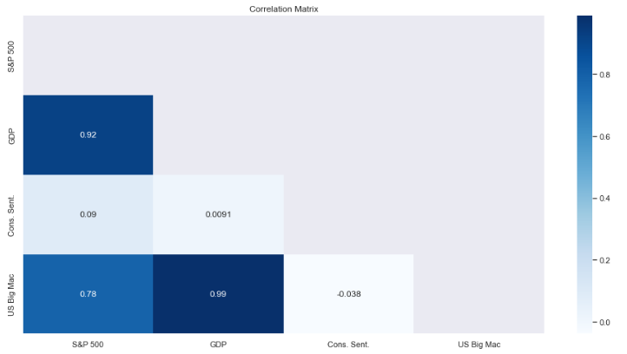
… and also to the GDP
Source: Quandl

Slide 16
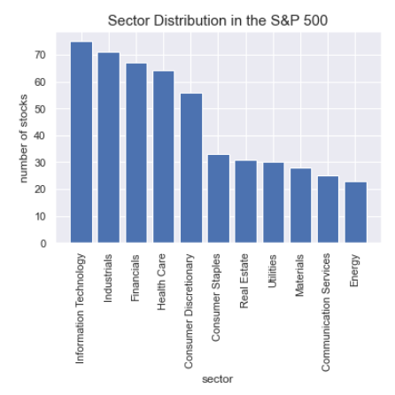
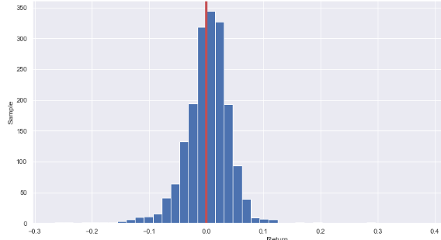
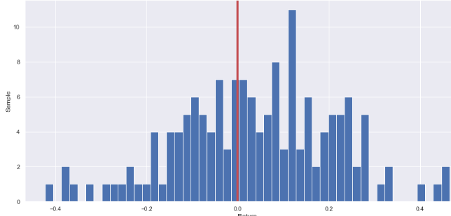
S&P 500 returns over time and the sector distribution
Comments
Sector Distribution in the S&P 500
Returns Distribution
Of 1823 months, 1032 were positive or 55% of the total number
Out of 152 years, 90 were positive or 59% of the total number
Note that these figures can change significantly depending on the number of years observed
Sector Distribution:
Of the 11 sectors represented in the S&P 500, 4 sectors account for more than half of the companies
Monthly Returns
Annual Returns
Source: Quandl & Wikipedia

Slide 17
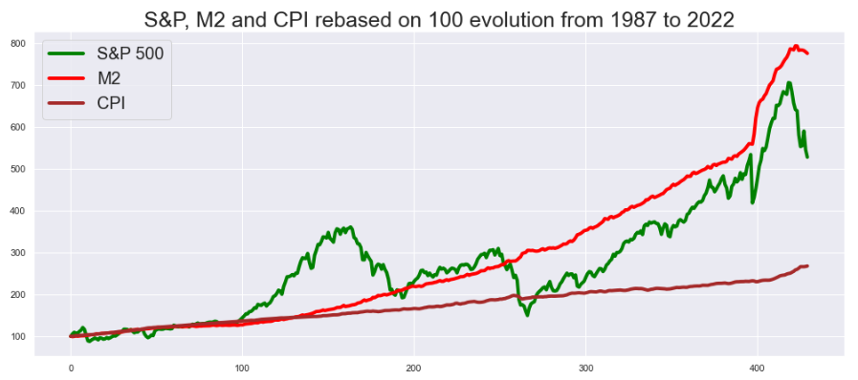
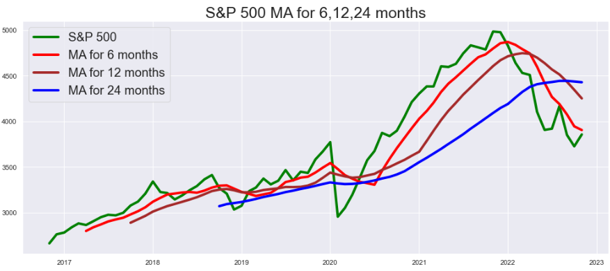

S&P 500 is lower than its moving averages and was influenced by a M2 kick
S&P 500 Moving Average
Calculated starting from 2017
S&P 500 is currently lower than the 6, 12 and 24 moving average
S&P 500 evolution compared to M2 and CPI:
Rebased the S&P 500, M2 and the CPI to 100 and saw their evolution over time to detect any common pattern
Even though S&P500 and M2 did not always share a similar pattern, it seems that the massive money injection during Covid played a role in the positive evolution of the S&P 500
Remember: Trust the process
Enjoy the ride
Keep pushing
Source: Quandl

Slide 18
04
Forecasting the price of the S&P 500

Slide 19
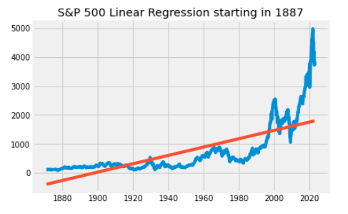
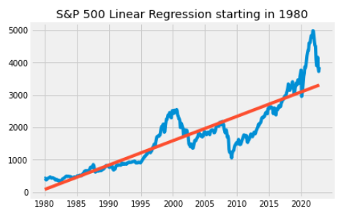
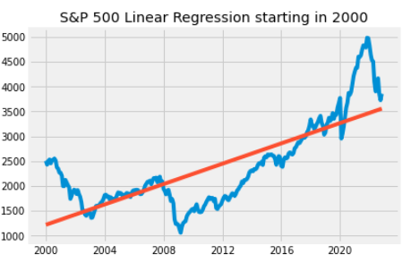
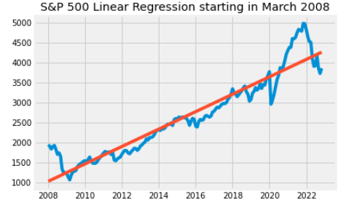
First Method: Linear Regression
Method
Graphs
Linear regression attempts to model the relationship between two variables by fitting a linear equation to observed data. One variable is considered to be an explanatory variable, and the other is considered to be a dependent variable. For example, a modeler might want to relate the weights of individuals to their heights using a linear regression model.
Results:
Linear regression starting in 1987
Intercept: -394 | Slope 1.20
R2 score: 0.55
Price for tomorrow should be: 1800
Linear regression starting in 1980
Intercept: 84 | Slope 6.29
R2 score: 0.79
Price for tomorrow should be: 3314
Linear regression starting in 2000
Intercept: 1217 | Slope 8.53
R2 score: 0.58
Price for tomorrow should be: 3566
Linear regression starting in 2008
Intercept: 1021 | Slope 18.19
R2 score: 0.89
Price for tomorrow should be: 4279
Source: Yale
Notes:
http://www.stat.yale.edu/Courses/1997-98/101/linreg.htm

Slide 20
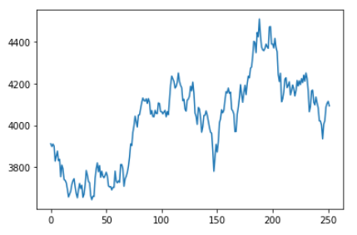
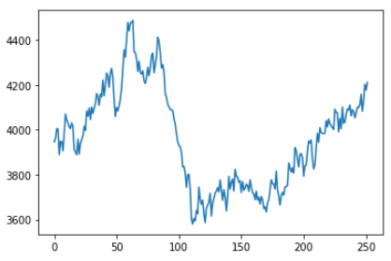
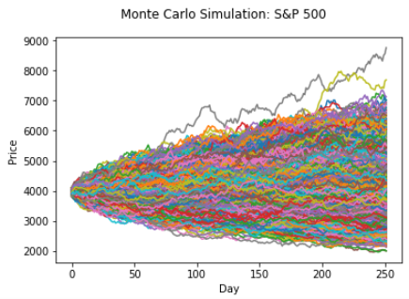
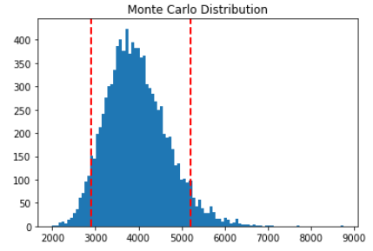
Second Method: Monte Carlo Simulation
Method
2 Monte Carlo Simulation
Monte Carlo simulation is a model used to predict the probability of a variety of outcomes when the potential for random variables is present.
Monte Carlo simulations help to explain the impact of risk and uncertainty in prediction and forecasting models.
Parameters:
Number of simulations 10’000
Period of the simulation: 252 days (equivalent of a trading year)
Daily volatility 0.11
Results:
Expected price: 3’959
Quantile (5%): 2’898
Quantile (95%): 5’218
10’000 simulations and the distribution
Source: Investopedia

Slide 21
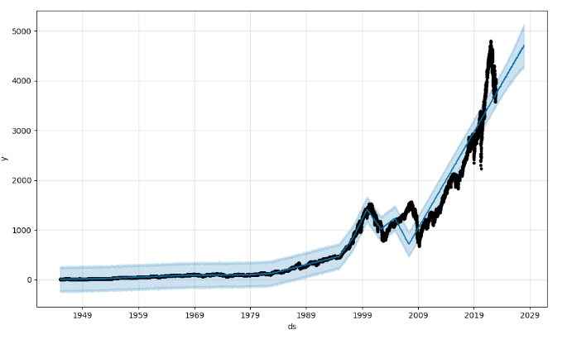
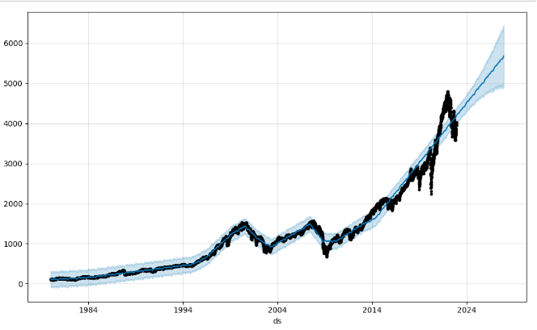
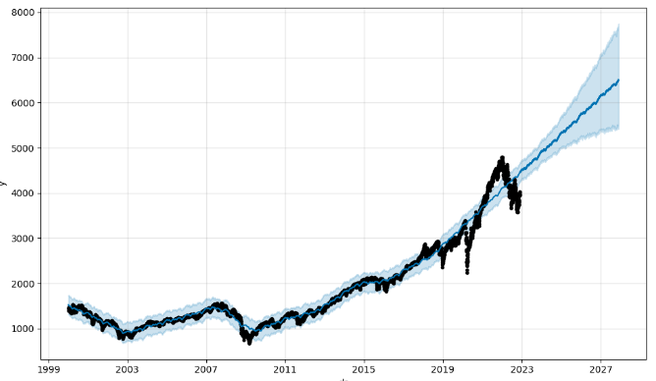
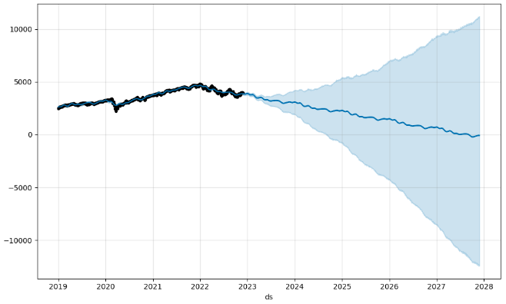
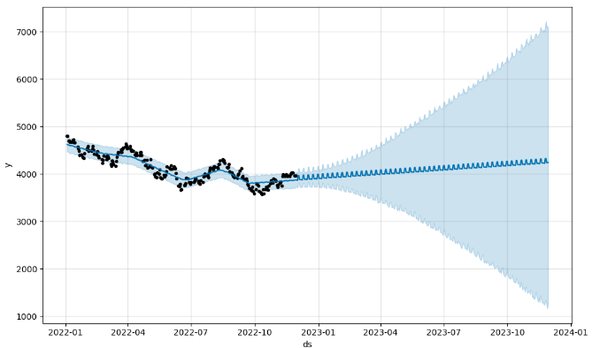
Third Method: Prophet
Method
Projection with data starting in 1945
Projection with data starting in 1980
Prophet is a procedure for forecasting time series data based on an additive model where non-linear trends are fit with yearly, weekly, and daily seasonality, plus holiday effects. It works best with time series that have strong seasonal effects and several seasons of historical data.
Prophet is open source software released by Facebook’s Core Data Science team.
Parameters
Forecasted period: 5 years (except for the last one)
Projection with data starting in 2000
Projection with data starting in 2019
Projection with data str. in 2019 – 1yr
Source: Facebook, Yahoo Finance

Slide 22
05
Conclusion

Slide 23
Conclusion
Main Finding
Outlook
Some indicators are at a record low/high, which is worrying for the short to medium term health of the economy
The S&P 500 is correlated to M2, but not only. CPI and Consumer Credits are also highly correlated to the S&P 500
Views on the evolution of the S&P 500 vary depending if the investment made is for the short or long term
Recession is coming, but it is not necessarily bad
Plausible level of S&P in the next 2-3 years: 3’800-4’600
What kind of investments to consider given the context:
Bonds
Private Markets
Real Estate
Main difficulties
Next steps
Finding the data – more difficulty than expected to find standardized data => Takeaway: always google first to find similar projects
Finding meaning with data can be tricky, especially by changing the scale of the observed period => Takeaway: always make test on different periods to be sure to understand the evolution of the data
Repeating the exercise with a more complex dataframe
Creating a cockpit of financial key indicators
Combining the acquired knowledge with the creation of a portfolio of stocks
1
2
3
Source: Frost&Sullivan, Statista

Slide 24
06
Annexes

Slide 25
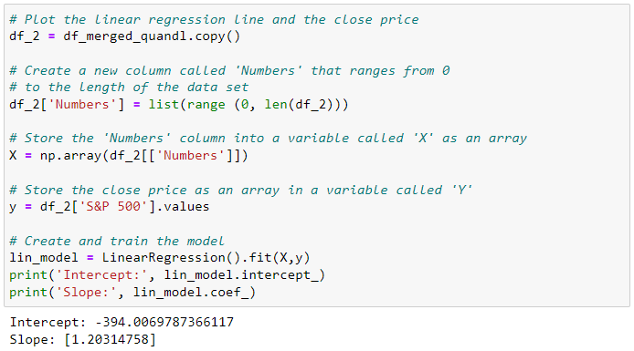
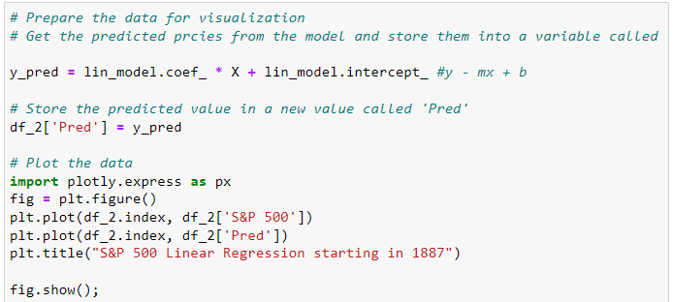
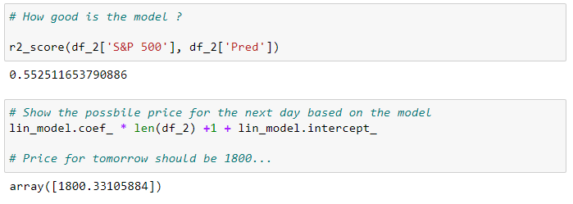
Code for the linear regression
Source: XerfiGlobal. (2021). Le marché mondial du transport aérien. Paris.

Slide 26
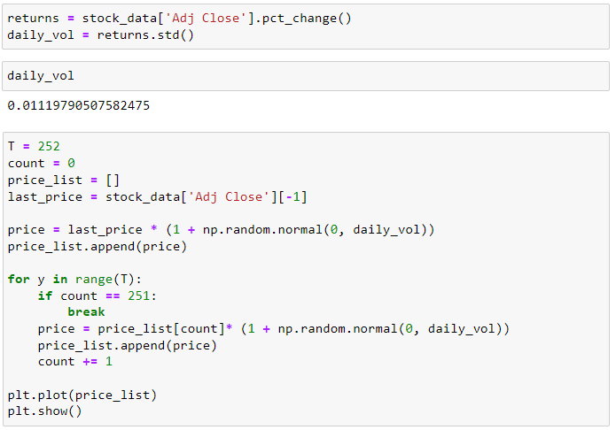
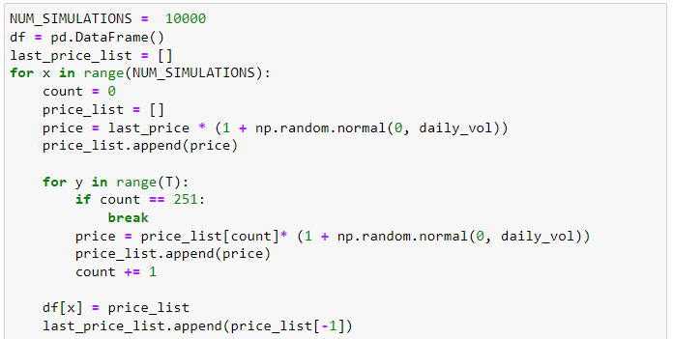
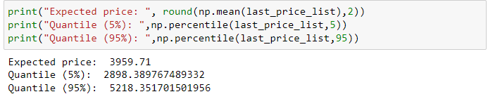
Code for the Monte Carlo Simulation
Source: XerfiGlobal. (2021). Le marché mondial du transport aérien. Paris.

Slide 27
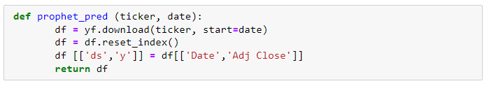
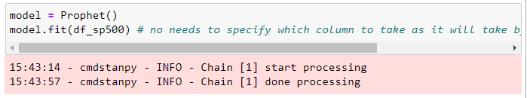
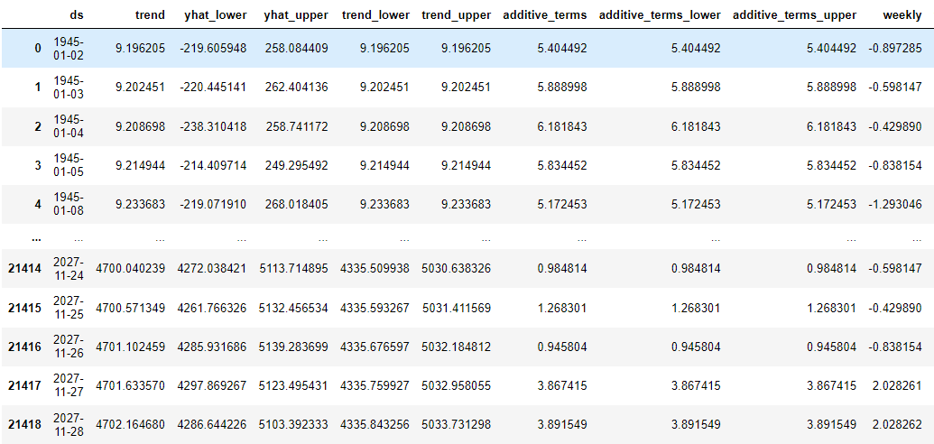
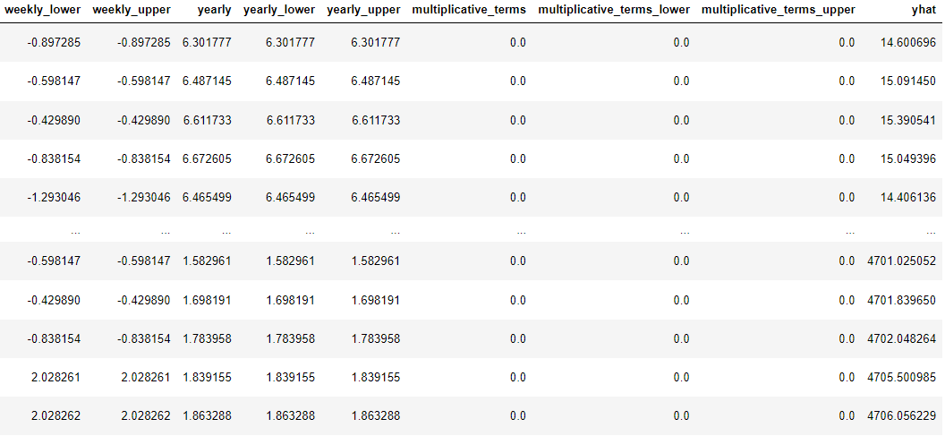
Code for Prophet
Source: XerfiGlobal. (2021). Le marché mondial du transport aérien. Paris.

Slide 28
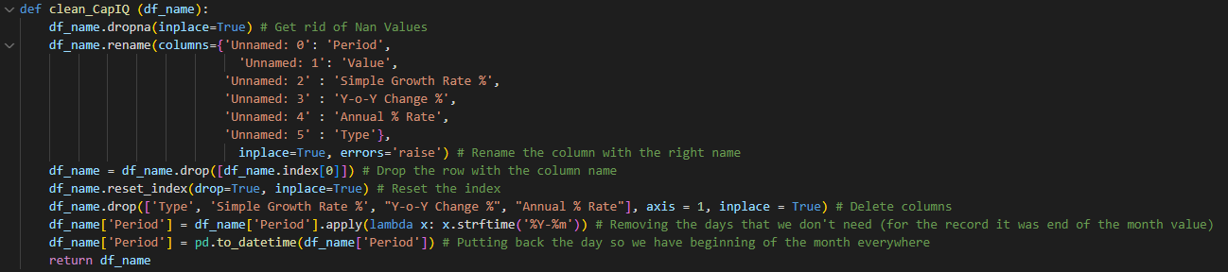
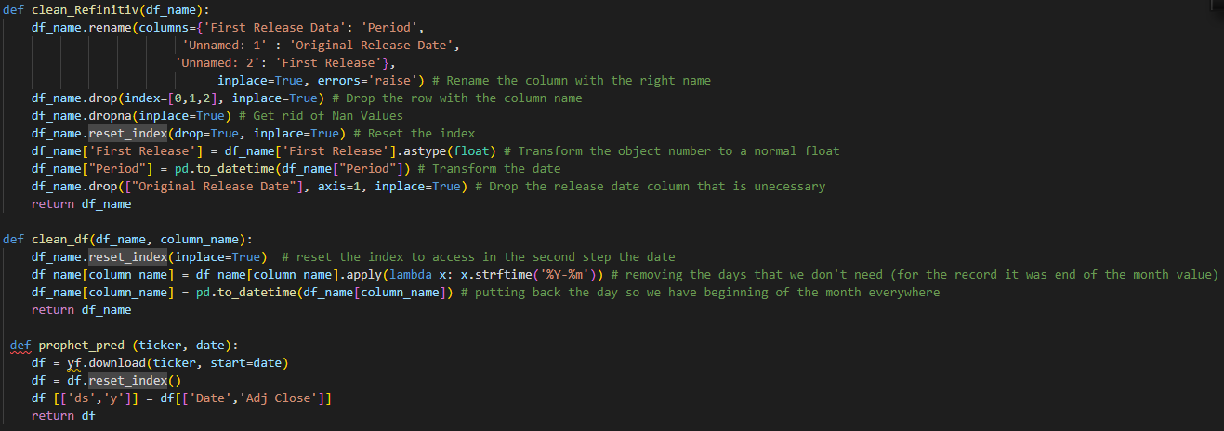
Functions
Source: XerfiGlobal. (2021). Le marché mondial du transport aérien. Paris.

